Slide 1
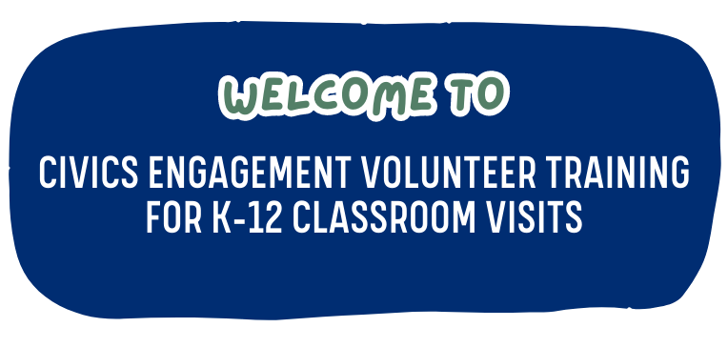
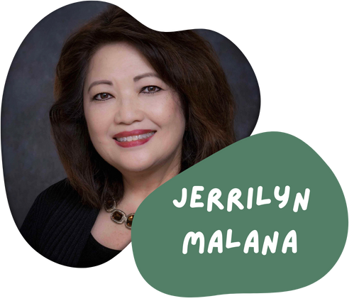
Chief Deputy District Attorney for the San Diego County District Attorney’s Office
Chair, Civic Engagement and Outreach Committee
Principal for Valensi Rose, PLC
Member, Civic Engagement and Outreach Committee
Notes:
Welcome attendees.
Introduce yourselves and the Civic Engagement & Outreach Committee.
Training will be recorded and made available to other interested volunteers.

Slide 2
Agenda Topics
Coordinating Classroom Visits
School Site Tips
Classroom Technology
Virtual Presentations
Available Materials
Join CLA’s Civic Engagement & Outreach Committee
Notes:
Review list of topics to be covered during this 20-minute presentation.

Slide 3
Classroom Visits – CLA Members and Friends
CLA coordinates K-12 classroom visits twice per year
Constitution Day/Month – September 17th
Law Day – May 1st
CLA staff can help individual volunteers year-round by request.
Email: initiatives@calawyers.org for support w/K-12 visits
Notes:
Key Points:
CLA’s offers active classroom visitation support during two key months – September and May.
Constitution Day is always on September 17th Law Day is always on May 1st
when these dates fall on a weekend, we generally aim for classroom placements within a week of those dates.
If a volunteer finds a unique opportunity to visit a classroom at another time, we can help by request.
Available help will include this training video with guidance on how to access and use the materials.

Slide 4
School Site Tips
Prior to classroom visit, obtain the following information:
Contact information for the point person at the school
School address and parking instructions
Information about the class (e.g., number of students, name of teacher, etc.)
Technology set up for classroom
Possibility of sending PowerPoint & materials ahead of time to teacher
Upon arrival at school:
Bring ID
Check in with school Administration Office for visitor badge
Ask for directions to classroom
Notes:
Every school is different, but we offer some general advice to prepare you for the visit.
Double check the address – in urban areas, it is common to have several schools with similar names.
Visit the main office first. Many schools have a secured campus that requires a visitor pass.
Bring your Driver’s License with you. Some schools (not all) will run you license through a card reader and create your visitor pass with a photo.
While in the office, confirm that your car is parked in the correct place (you may need a parking permit, depending on the campus).
Some schools will offer a student guide to walk you to the correct classroom.

Slide 5
Classroom Technology
Classrooms are equipped with a variety of audio-visual tools. A best practice is to request that the teacher have the presentation set up for you on a screen. However, sometimes things don’t work as planned so you should have a Plan B.
Plan B - You are your own IT support:
Bring files on a thumb drive
Email files to yourself for access from classroom PCs
Bring your own PC to connect to classroom A/V equipment
Bring some hard copy printouts of your program
Notes:
IT support – you’re it.
Some classrooms have Apple products, others have Windows based technology.
Teachers can generally help you get set up but it helps to have multiple options.
Technology Tips:
Bring the files on a thumb drive.
Email yourself the specific materials you will be using in the classroom.
Consider bringing your own laptop to connect to the Audio Visual system.
Consider bringing a printed version (just in case).
If technology fails, don’t be flustered - you are a lawyer. You know this stuff well!

Slide 6
Virtual Presentations
Prior to virtual presentation:
Determine technology platform you will use (e.g., Zoom, Teams, etc.)
Obtain direct contact information for teacher including cell number for emergencies on day of program
Connect with teacher and obtain information about the class (e.g., number of students, etc.)
Send virtual link and other materials to teacher so teacher can forward to students
Ask teacher to assist you during presentation to ensure students are engaged
Conduct technology test run with teacher

Slide 7
Virtual Presentations
During presentation:
Engage students in interactive discussions
Be mindful of students’ short attention span
Monitor chat function for questions/comments
In addition to PowerPoint, consider additional props or other visual aids
Have a backup plan if your PowerPoint or video fails

Slide 8
CLA has a fantastic collection of civics content to share with educators and students.
Website:
https://calawyers.org/initiatives/civics-engagement-and-outreach/
Dropbox File Access – View/Download: https://www.dropbox.com/sh/1zrzpb1fwlnwy0m/AAB6fv-Olael7EWAQhhytLsUa?dl=0
Civics
Material

Slide 9
Civics Resource | Recommended Grade Level | Description
Comic Book: What Lawyers and Judges Do? | K-5 | This publication serves to engage students at an early age and introduces them to the role of attorneys and judges through several illustrated examples. It lets students know they can grow up to be legal professionals.
Worksheet: No Animals Allowed (The Rule of Law) | 3-5 | This worksheet creates a lively discussion on the three branches of government. Students also learn about the rule of law through an exercise on whether animals should be allowed in school.
Toolkit: Celebration of the 19th Amendment | 5-8 | This toolkit supports discussion around the U.S. Constitution, the right to vote generally, the women’s suffrage movement, and the right to vote.
Presentation and Activity: The Bill Making Process | 7-10 | This presentation features state legislators and offers an explanation of how laws are made in California. It includes videos and classroom activity options.
Brochure: When you Turn 18 | Age 16-18 | This resource covers many of the legal considerations that new adults face. Also available in Spanish.
Video Series: Youth Interactions with Law Enforcement | Age 8-18 | Coming Soon: This 6-part video series guides youth on safely interacting with law enforcement, and reviews their rights and responsibilities.
Notes:
CLA offers a variety of age-appropriate materials for K-12 classroom visits. You can access the existing materials in our DropBox (reference link).
If you have questions or need assistance, please email initiatives@calawyers.org
Dropbox allows access without membership.

Slide 10
Find More #FutureLawyers
Join CLA’s Civic Engagement & Outreach Committee
Update civics content
Create new civics content
Connect more attorneys and judges with civic engagement efforts
Help us find more Future Lawyers.
If interested, email initiatives@calawyers.org

Slide 11
Questions?

